Slide 1



Submit For Job Submission
HUBzero
Grid
Submit
Proxy
Derrick Kearney
HUBzero® Platform for Scientific Collaboration
Purdue University
This work licensed under
Creative Commons
See license online:
by-nc-sa/3.0

Slide 2
Running locally in a Workspace
User's Workspace Terminal
HUBzero Infrastructure
$ echo hi
Tool Session
Containers
Submit
Proxy
Grid
Grid
Grid
Grid
Grid
Grid

Slide 3
Big Work, Big Computers
my_super_awesome_program_to_cure_cancer.exe
Grid
Grid
100,000
Idle CPUs

Slide 4
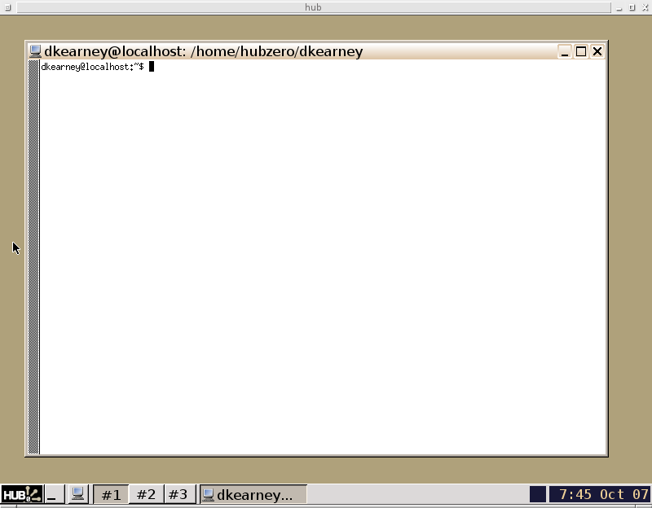
Big Work, Big Computers
my_super_awesome_program_to_cure_cancer.exe
$ ssh me@the-grid.com
me@the-grid.com's password:
password rejected
Error #9: Your not cool enough
Grid
Grid
100,000
Idle CPUs

Slide 5
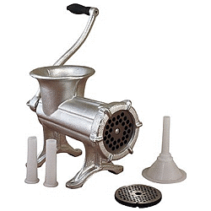
Big Work, Big Computers
my_super_awesome_program_to_cure_cancer.exe
$ ssh me@the-grid.com
me@the-grid.com's password:
$ make all install
Library Version Errors...
Grid
Grid
100,000
Idle CPUs

Slide 6
Big Work, Big Computers
my_super_awesome_program_to_cure_cancer.exe
$ ssh me@the-grid.com
me@the-grid.com's password:
$ ./my_super_awesome_program_to_cure_cancer.exe \
datafile1 datafile2
Grid
Grid
100,000
Idle CPUs

Slide 7
Big Work, Big Computers
my_super_awesome_program_to_cure_cancer.exe
$ ssh myfriend@the-grid.com
myfriend@the-grid.com's password:
password rejected
Error #9: Your friend isn't cool enough either!
Grid
Grid
100,000
Idle CPUs

Slide 8
Running locally in a Workspace
User's Workspace Terminal
HUBzero Infrastructure
$ echo hi
hi
$
Tool Session
Containers
Submit
Proxy
Grid
Grid
Grid
Grid
Grid
Grid

Slide 9
Submitting from a Workspace
User's Workspace Terminal
HUBzero Infrastructure
$ submit echo hi
Tool Session
Containers
Submit
Proxy
Grid
Grid
Grid
Grid
Grid
Grid

Slide 10
Submitting from a Workspace
User's Workspace Terminal
HUBzero Infrastructure
$ submit echo hi
Tool Session
Containers
Submit
Proxy
Grid
Grid
Grid
Grid
Grid
Grid

Slide 11
Submitting from a Workspace
User's Workspace Terminal
HUBzero Infrastructure
$ submit echo hi
Tool Session
Containers
Submit
Proxy
Grid
Grid
Grid
Grid
Grid
Grid

Slide 12
Submitting from a Workspace
User's Workspace Terminal
HUBzero Infrastructure
$ submit echo hi
hi
$
Tool Session
Containers
Submit
Proxy
Grid
Grid
Grid
Grid
Grid
Grid

Slide 13
The Submit Command
User's Workspace Terminal
HUBzero Infrastructure
$ submit --help
-l, --local Execute command
locally
-v, --venue Remote job destination
-i, --inputfile Input file
-p, --parameters Parameter sweep
variables.
-d, --data Parametric variable
data - csv format
...
Tool Session
Containers
Submit
Proxy
Grid
Grid
Grid
Grid
Grid
Grid

Slide 14
Submitting locally in a Workspace
User's Workspace Terminal
HUBzero Infrastructure
$ submit --local echo hi
Tool Session
Containers
Submit
Proxy
Grid
Grid
Grid
Grid
Grid
Grid

Slide 15
Submitting locally in a Workspace
User's Workspace Terminal
HUBzero Infrastructure
$ submit --local echo hi
Tool Session
Containers
Submit
Proxy
Grid
Grid
Grid
Grid
Grid
Grid

Slide 16
Submitting locally in a Workspace
User's Workspace Terminal
HUBzero Infrastructure
$ submit --local echo hi
hi
$
Tool Session
Containers
Submit
Proxy
Grid
Grid
Grid
Grid
Grid
Grid

Slide 17
What commands can I submit?
HUBzero Infrastructure
Submitting locally with --local
Any executable can be used
when submitting locally
Submitting to the grid
Only executables staged in /apps
can be submitted to the grid
Tool Session
Containers
Submit
Proxy
Grid
Grid
Grid
Grid
Grid
Grid

Slide 18
Try it: submit command locally
HUBzero Infrastructure
$ submit --local \
/apps/pegtut/current/bin/sayhi f.a
Hello pete!
Tool Session
Containers
Submit
Proxy
Grid
Grid
Grid
Grid
Grid
Grid

Slide 19
Try it: submit command to the grid
HUBzero Infrastructure
$ submit /apps/pegtut/current/bin/sayhi f.a
Hello pete!
Tool Session
Containers
Submit
Proxy
Grid
Grid
Grid
Grid
Grid
Grid

Slide 20
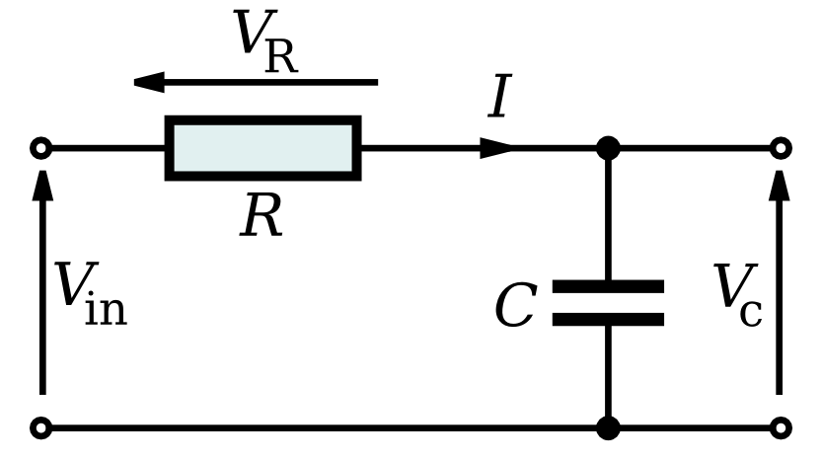
Sweeping Variables
Vc(t)= Vin*(1-exp(-t/(R*C)))
def Vc(Vin,R,C,lowerbound,upperbound):
# store all solutions
s = {'t':[],'v(t)':[]}
for t in frange(lowerbound,upperbound,(upperbound-lowerbound)/100.0):
v = Vin*(1-exp(-t/(R*C)))
s['t'].append(t)
s['v(t)'].append(v)
return s

Slide 21
Sweeping Variables
Vc(t)= Vin*(1-exp(-t/(R*C)))
$ ls /apps/pegtut/current/examples/sim1.py --help
Usage: sim1.py [options]
Options:
-h, --help show this help message and exit
--Vin=VIN Input voltage to the system with units of volts (V)
--R=R Impedance of the resistor with units of ohms
--C=C Capacitance of the capacitor with units of farads (F)
--lowerbound=LB Lower bound of the time frame to examine in seconds (s)
--upperbound=UB Upper bound of the time frame to examine in seconds (s)
--log=LOG Name of the file used to store results

Slide 22
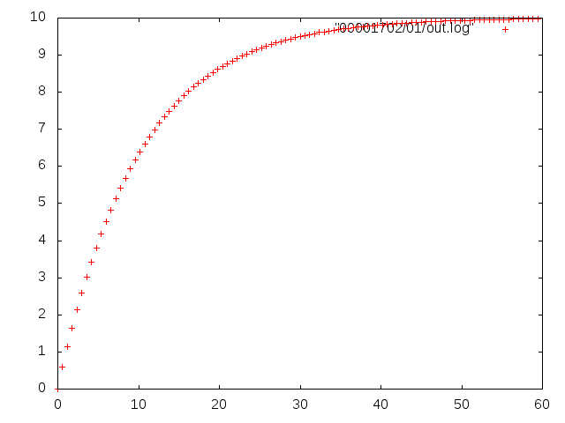
Sweeping Variables
Vc(t)= Vin*(1-exp(-t/(R*C)))
$ /apps/pegtut/current/examples/sim1.py
$ /apps/pegtut/current/examples/sim1.py --Vin 10
$ /apps/pegtut/current/examples/sim1.py --R 100e3
$ /apps/pegtut/current/examples/sim1.py --C 100e-6

Slide 23
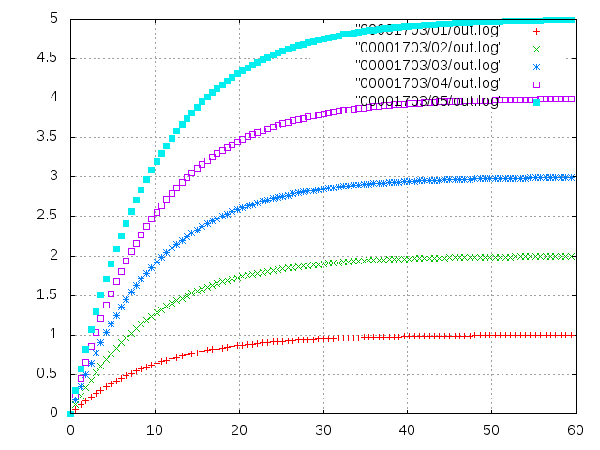
Sweeping Variables
Vc(t)= Vin*(1-exp(-t/(R*C)))
$ /apps/pegtut/current/examples/sim1.py
$ /apps/pegtut/current/examples/sim1.py --Vin 1
$ /apps/pegtut/current/examples/sim1.py --Vin 2
$ /apps/pegtut/current/examples/sim1.py --Vin 3
$ /apps/pegtut/current/examples/sim1.py --Vin 4
$ /apps/pegtut/current/examples/sim1.py --Vin 5

Slide 24
Sweeping Variables
Vc(t)= Vin*(1-exp(-t/(R*C)))
$ submit -p @@Vin=1,2,3,4,5 ./sim1.py --Vin @@Vin

Slide 25
Sweeping Variables
Vc(t)= Vin*(1-exp(-t/(R*C)))
$ submit -p @@Vin=1-5 ./sim1.py --Vin @@Vin

Slide 26
Sweeping Variables
Vc(t)= Vin*(1-exp(-t/(R*C)))
$ submit -p @@Vin=1:1:5 ./sim1.py --Vin @@Vin

Slide 27
Sweeping Variables
Vc(t)= Vin*(1-exp(-t/(R*C)))
$ submit -d input.csv ./sim1.py --Vin @@Vin
input.csv
@@Vin
1
2
3
4
5

Slide 28
Sweeping Variables
Vc(t)= Vin*(1-exp(-t/(R*C)))
$ submit -d input.csv ./sim1.py --Vin @@Vin --C @@C
input.csv
@@Vin,@@C
1, 100e-6
2, 100e-6
3, 100e-6
4, 100e-6
5, 100e-6

Slide 29
Sweeping Variables
Vc(t)= Vin*(1-exp(-t/(R*C)))
$ submit -p params ./sim1.py --Vin @@Vin --C @@C
params
parameter @@Vin=1:1:5
parameter @@C=100e-6

Slide 30
Sweeping Variables
Vc(t)= Vin*(1-exp(-t/(R*C)))
$ cp -r /apps/pegtut/current/examples/capacitor_voltage .
$ cd capacitor_voltage
$ submit --local -p @@Vin=1,2,3,4,5 ./sim1.py --Vin @@Vin
$ submit --local -p @@Vin=1-5 ./sim1.py --Vin @@Vin
$ submit --local -p @@Vin=1:1:5 ./sim1.py --Vin @@Vin
$ submit --local -d input.csv ./sim1.py --Vin @@Vin
$ submit --local -p params ./sim1.py --Vin @@Vin
$ submit --local -p @@Vin=1-10 -p @@C=100e-6,100e-5 \
./sim1.py --Vin @@Vin --C @@C
# Check your plots quickly with “./plotsweep.py <job-directory>” :
$ ./plotsweep.py 00001720

